Slide 1
Android App & Activity Lifecycle
Lecture 5
K.M Shadman Wadith
Lecturer
Department of CSE

Slide 2
Android Applications and Resource Management
Each running Android application is viewed by the operating system as a separate process
terminate processes to free up memory when reaching capacity
Lower priority process are terminated first

Slide 3
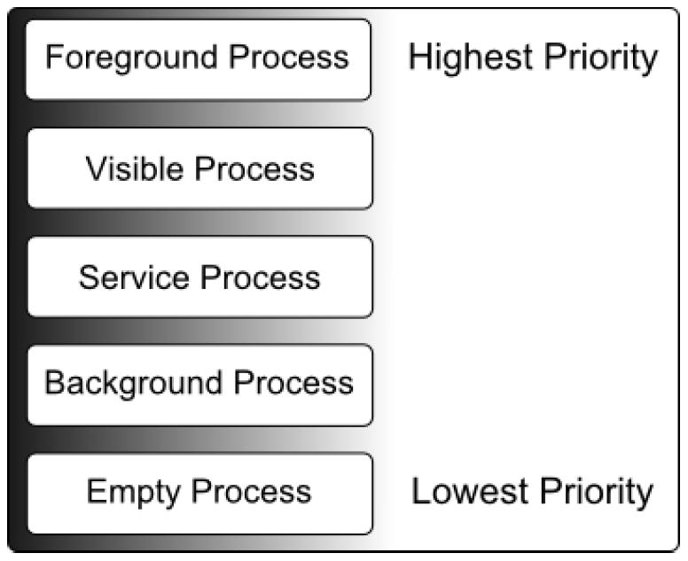
Android Process States

Slide 4
Foreground Process
Highest level of priority
Unlikely to be more than one or two foreground processes active
Usually terminated by the system

Slide 5
Foreground Process
Example:
Hosts an activity with which the user is currently interacting.
Hosts a Service connected to the activity with which the user is interacting.
Hosts a Service that has indicated, via a call to startForeground(), that termination would be disruptive to the user experience.

Slide 6
Visible Process
Visible to the user but is not the activity with which the user is interacting
Partial screen or dialogue
Foreground Activity is displayed as a dialog that lets the previous Activity be seen behind it
Example - Weather Activity, Launcher

Slide 7
Service Process
Processes that contain a Service that has already been started and is currently executing.
Not directly visible to the user, they are generally doing things that the user cares about
Example - Music Playing in the background, Paused Activity

Slide 8
Background Process
Not currently visible to the user
does not host a Service that qualifies for Service Process status
Android maintains a dynamic list of background processes

Slide 9
Empty Process
No longer contain any active applications
Held in memory ready to serve as hosts for newly launched applications
Analogous to keeping the doors open and the engine running on a bus in anticipation of passengers arriving
lowest priority

Slide 10
Inter-Process Dependencies
Relationships and interactions between different processes or components
Android system will also take into consideration whether the process is in some way serving another process of higher priority

Slide 11
The Activity Lifecycle
The state of an Android process is determined largely by the status of the activities
onCreate()
onStart()
onResume()
onStop()

Slide 12
The Activity Stack
When an application is launched, the first of the application’s activities to be started is placed onto the stack.
The activity at the top of the stack is referred to as the active
When the active activity exits, it is popped off the stack by the runtime and the activity located immediately beneath it in the stack becomes the current active activity

Slide 13
The Activity Stack
An activity can be in one of a number of different states during the course of its execution within an application:
Active / Running
Paused
Stopped
Killed

Slide 14
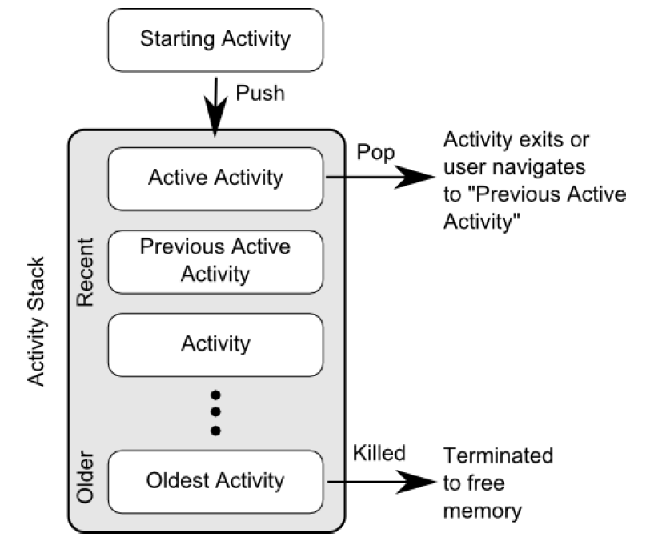
The Activity Stack

Slide 15
Configuration Changes
Any configuration change that impacts the appearance of an activity
Rotating the orientation of the device between portrait and landscape, or changing a system font setting
Changes affect resources such as the layout of the user interface

